Slide 1

API GATEWAY
Using spring boot microservices

Slide 2

agenda
What are Microservices
Benefits of microservices
How to Integrate microservices with API gateway
Why Implement API gateway in microservices
What is API gateway
Benefits of API gateway
What is cloud config server

Slide 3
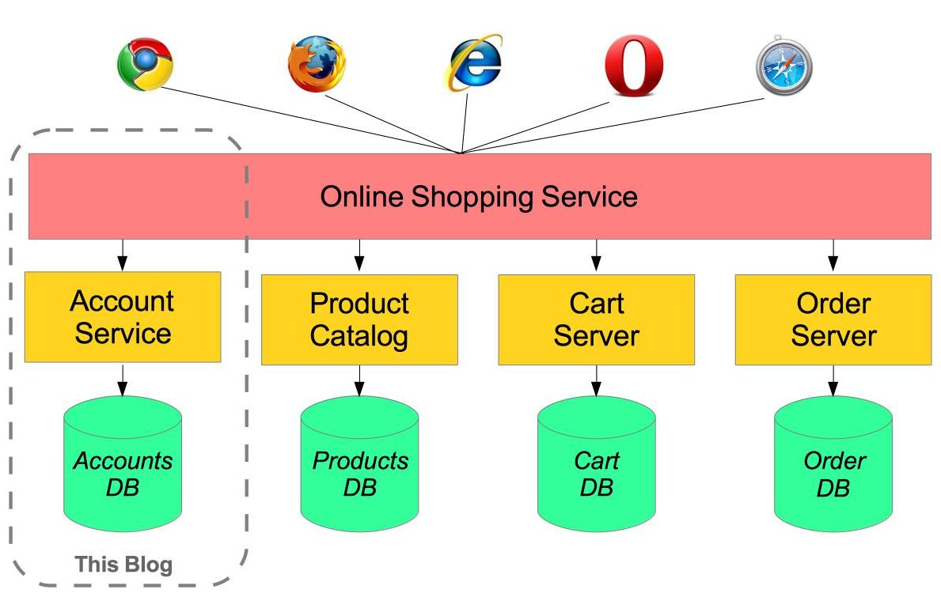
MICROSERVICES
Microservices Architecture is a design approach in software development where an application is composed of small, independent services that communicate with each other over well-defined APIs. Each service is responsible for a specific business function and can be developed, deployed, and scaled independently.
Spring Boot is a popular framework for building microservices in Java due to its simplicity, speed, and rich ecosystem.

Slide 4
BENEFITS OF MICROSERVICES
SCALABILITY
FLEXIBILITY
FASTER DEVELOPMENT
EASIER MAINTENANCE

Slide 5
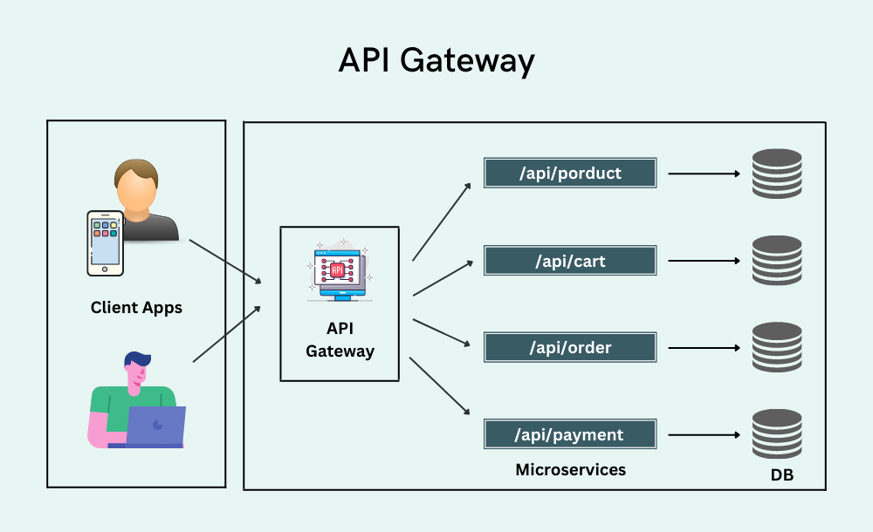
API GATEWAY
API Gateway is a server that acts as an intermediary between clients (such as web browsers or mobile apps) and microservices in a distributed system.
It serves as the single entry point for all client requests, routing them to the appropriate microservice, and handling various cross-cutting concerns such as authentication, authorization, load balancing, caching, and rate limiting.

Slide 6
WHY IMPLEMENT API GATEWAY IN MICROSERVICES
An API gateway simplifies the communication between a client and a service, whether that be between a user’s web browser and a server, or between a frontend application and the backend application that it relies on.
The main purpose of integrating the API gateway in microservice communication is, API Gateway acts as a single entry point to access services.

Slide 7
BENEFITS OF API GATEWAY
SINGLE ENTRY POINT
ROUTING
CACHING
LOAD BALANCING
SECURITY
SERVICE DISCOVERY

Slide 8
CLOUD CONFIG SERVER
Spring Cloud Config Server is a central configuration management solution that provides server-side and client-side support for externalized configuration in a distributed system.
It enables you to manage and serve configuration properties for multiple applications across different environments from a central location.

Slide 9
How to integrate microservices with api gateway and cloud config server
Set Up the Eureka Server
Set Up the Cloud Config Server
Register Microservices with Eureka
Configure the API Gateway

Slide 10

Thank You

